Slide 1
CIFAR10
Gwen, Xindi, Olivia, Malka, Salena, Joyce
Notes:
Salena
Say ur own names

Slide 2
Table of contents
01.
Introduction
03.
Hyper parameters
02.
Network Architecture
04.
Model Performance
Overview
Describe other hyper-parameters
Describe architecture
Loss and accuracy
Notes:
Salena
This is our table of contents, and the things we’ll be covering in the presentation.

Slide 3
Table of contents
05.
Result Visuals
07.
Challenges
06.
Resolutions
08.
Conclusion
The challenges we faced while coding
How we solved challenges
Notes:
Salena

Slide 4
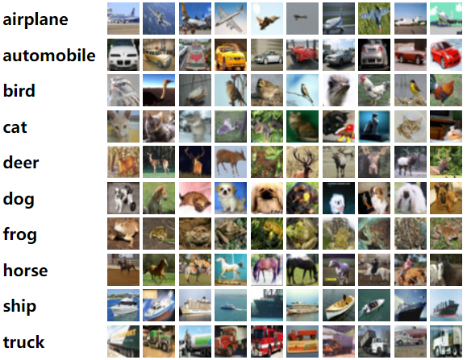
Introduction
CIFAR10:
10 different categories
60,000 images
Task:
Create and train a neural network (CNN) for calibrated for accuracy in image classification
Image classification:
method to classify images into specific categories
Notes:
Joyce: The CIFAR10 dataset consists of 60,000 32x32 color images in 10 different classes (Airplane, Automobile, Bird, Cat, Deer, Dog, Frog, Horse, Ship, and Truck), with 6,000 images per class. Coding projects involving CIFAR-10 range from building simple image classification models using traditional machine learning techniques to designing complex deep neural networks. Through the process of trial and error, we created and trained a sophisticated convolutional neural network (CNN) for improved accuracy in image classification. Image classification is the method to classify images into specific categories

Slide 5
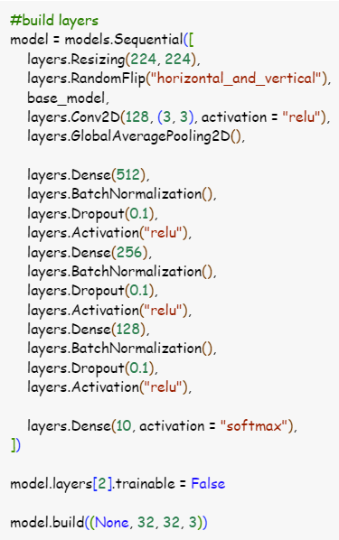
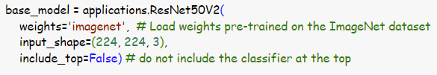
ResNet Architecture
Structure:
Uses ResNet 50 V2
Multiple dense layers with normalization and dropouts after each one
Theory:
Multiple convolutional layers
Skip connections
Prevents explosions and vanishing gradients
Normalization and dropouts to
prevent overfitting (partially
successful)
Total params: 26,159,370

Slide 6
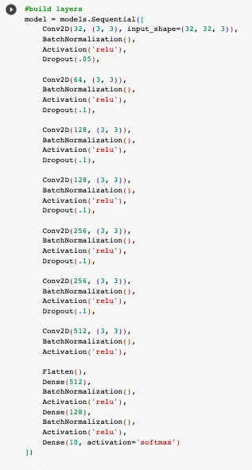
Network Architecture
Structure:
Operates in blocks
Each would convolute, normalize, activate, and use dropout
Was flattened then put through dense layers
Theory:
The neurons fan out for convolute and in for dense to preserve the most data possible
Dropouts after every block to prevent overfitting (partially successful)
Total params: 87,316,426
Notes:
GWEN
-the fan model used repeating blocks of layers that iterated with different quantities of neurons
-each block would use layers for convolution, batch normalization, activation, and finally implemented dropout
- a layer to flatten
-Then passed into dense layers, batch normalization, and an activation
-the fan directions were crucial to the function of the model
-the neurons in colvolutions increase to catch more data and the dense layers decrease down to the 10 outputs
-the dropouts are implemented to reuse overfitting
-but in training, the highest val accuracies were not best loss values
so an overfitting of the model produced higher results

Slide 7
Hyperparameters
Optimizer → Adam
Batch_size
ResNet: 128 Fan: 64
Epochs
ResNet: 3 Fan: 30
Workers
Activation → ReLU, Softmax
Notes:
Salena Optimizer Choice: We opted for the Adam optimizer, improving its adaptive learning rate capabilities with gradient descent. This benefits each weight in our neural network.
Batch Size Impact: The batch size significantly influences key aspects like training time, quality of the model, and training time per epoch. We selected a batch size of 128 for our experiment.
Parallelization: To enhance speed during training, we increased the number of workers to 32, allowing for efficient parallel processing.
Activation Functions: We utilized the ReLU activation function for our hidden layers. This choice aligns with its effectiveness in these layers. Additionally, we retained the softmax activation function for the output layer, serving our specific needs.

Slide 8
Model Performance
ResNet
Train acc: 95.59%
Val acc: 89.22%
Test acc: 84.51%
Fan
Train acc: 97.79%
Val acc: 78.04%
Test acc: 76.00%
Notes:
Malka - after training our data, we found that ResNet gave better results than Fan. For ResNet, our train acc was 95%, and val accuracy was 89% – for Fan, our train acc was 97% and out val accuracy was 78% – we found that slightly overfitting was effective.

Slide 9
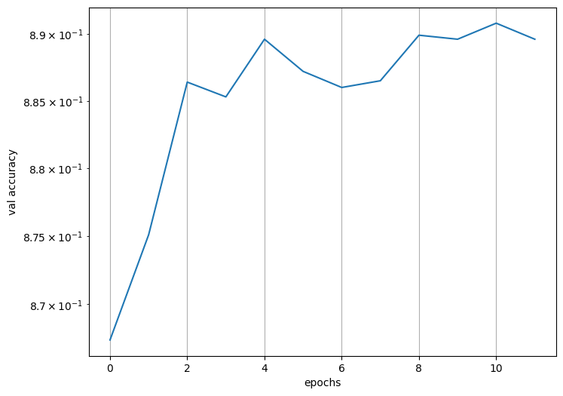
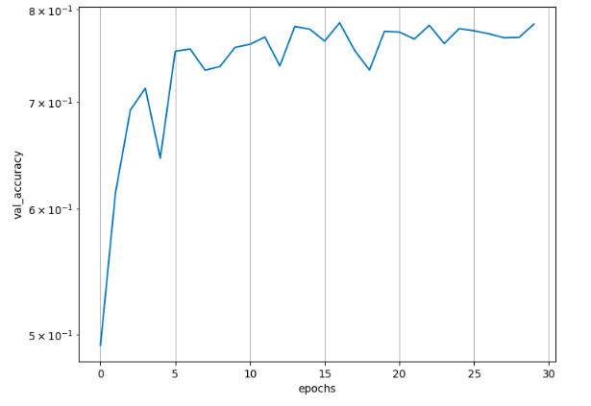
Progression of Val Accuracy
ResNet
Fan Model
Notes:
Gwen - Both graphs show a clear upwards trend, the val accuracies increased as the models completed more epochs and learned better fits until they leveled out within a consistent range

Slide 10
Challenges
Problems
Epoch run time errors
Overfitting
Resnet adaptation
10% val_accuracy
Solutions
GP4 and include_top=False
Regularization
Checking runtime type
Fanning in correct direction
Notes:
Olivia - Over the course of out project, we experienced a few setbacks. One was the Epoch run time errors, which we fixed by switching to GP4. Our next problem was overfitting, which we prevented by using regularization. Another problem was resnet adaptation, which we solved by checking the runtime type, which helps ensure that the data we were working with aligned with the expected data types and shapes.

Slide 11
Conclusion
ResNet > Fan
Notes:
Salena -
Overall, to conclude from these results, the ResNet model was more accurate than fan since slightly overfitting was effective.

Slide 12
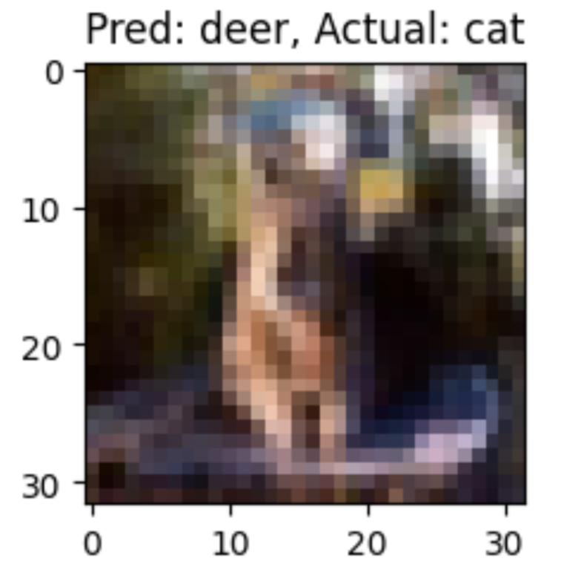
Thank You!

